Slide 1

What is on consumers’ minds?

Slide 2
Overview
History of Amazon Pharmacy
Original research proposal
Data collection
Challenges
Tweet analysis
Webhose analysis
Model evaluation
Lessons learned

Slide 3
Understanding Amazon Pharmacy

Slide 4
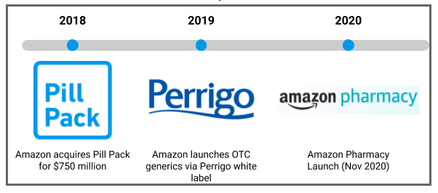
Amazon Pharmacy Timeline

Slide 5
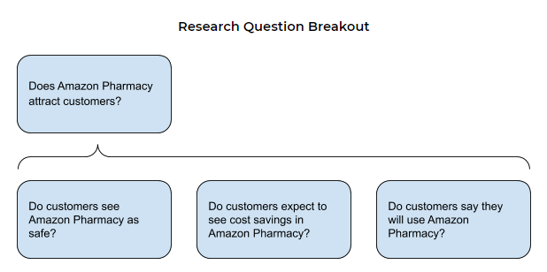
Research Questions
Pivoted to include thoughts about safety and delivery

Slide 6


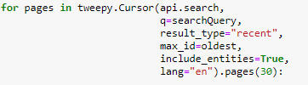
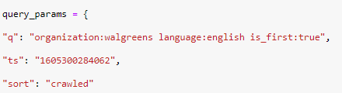
Sources
Twitter Tweepy/Tweepy Cursor Search Terms:
Amazon Pharmacy
CVS
Walgreens
Filters: -filter:retweets -filter:vaccine
Webhose Webhoseio
Search Terms:
“Amazon Pharmacy”
organization:cvs
organization:walgreens
Filters: language:english, is_first:true
Notes:
WordNetLemmatizer, nltk stopwords

Slide 7
Challenges
Spam & Relevance
Recent launch
Amazon Pharmacy was launched only one month ago
Data sources not clearly addressing the company or its pharmacy service
Not yet launched in every state
Users are still getting familiar with the service
Most of the data are announcements without additional commentary
Large amounts of data, but not regarding our research
Difficulties in getting enough postings
Early “sense checks” on data availability were later contradicted

Slide 8
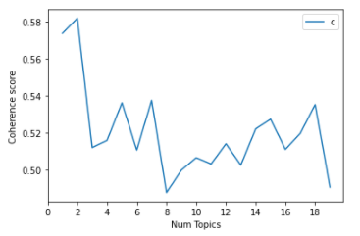

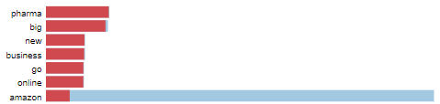


Topic Clustering - Amazon Pharmacy Tweets
Gensim CoherenceModel
c_v measure
Topic Highlights:
Implications:
People are not talking about Amazon Pharmacy on Twitter (473 Tweets, 2 topics)
Most tweets are about the launch of the business and Apollo investment
Topic coherence gives you a good picture so that you can take better decision
Score suggests there is not improvement with higher numbers of topics
22
Notes:
degree of semantic similarity between high scoring words in the topic. These measurements help distinguish between topics that are semantically interpretable topics and topics that are artifacts of statistical inference.
Topic coherence gives you a good picture so that you can take better decision. C-v measure. Tried U-Mass more easily interpretable.
Passes based on computing power and experimentation.

Slide 9
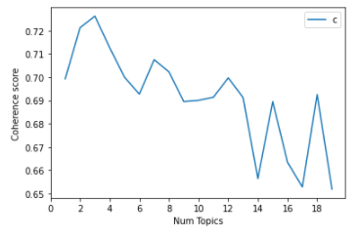


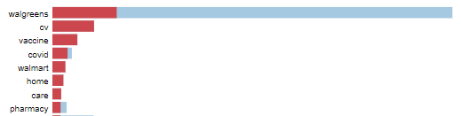
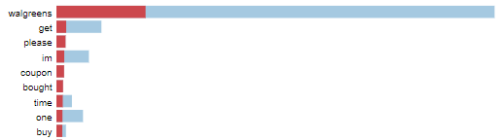
Topic Clustering - Walgreens Tweets
Gensim CoherenceModel
Topic Highlights:
c_v measure
Implications:
11733 original tweets, 7 topics
Topics include COVID/vaccine, home care, promotions/coupons and hair products
22

Slide 10
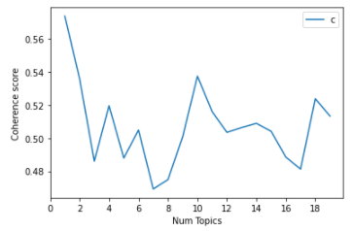


Topic Clustering - CVS Tweets
Gensim CoherenceModel
c_v measure
Topic Highlights:
Implications:
15566 original tweets, 2 topics
Topics came down to two areas: COVID/vaccine and jobs/hiring
Topics became repetitive with more than 2
22

Slide 11
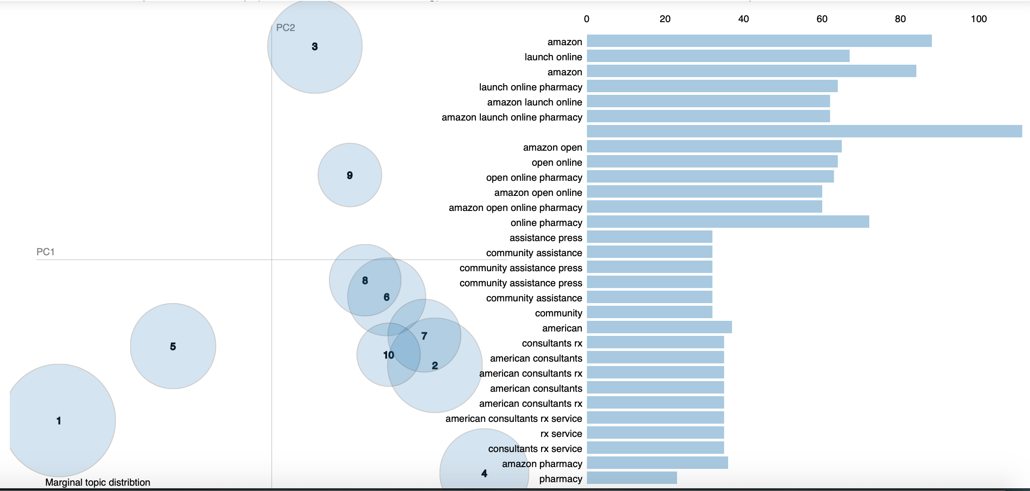
Topic Clustering - Amazon Webhose
Processing:
Almost 3.000 posts
LDA Topic Modeling
Safety and delivery specific taxonomy
Implications:
No articles on opinion about the service yet
Industry still shook up about the new launch
35
25
22
15

Slide 12
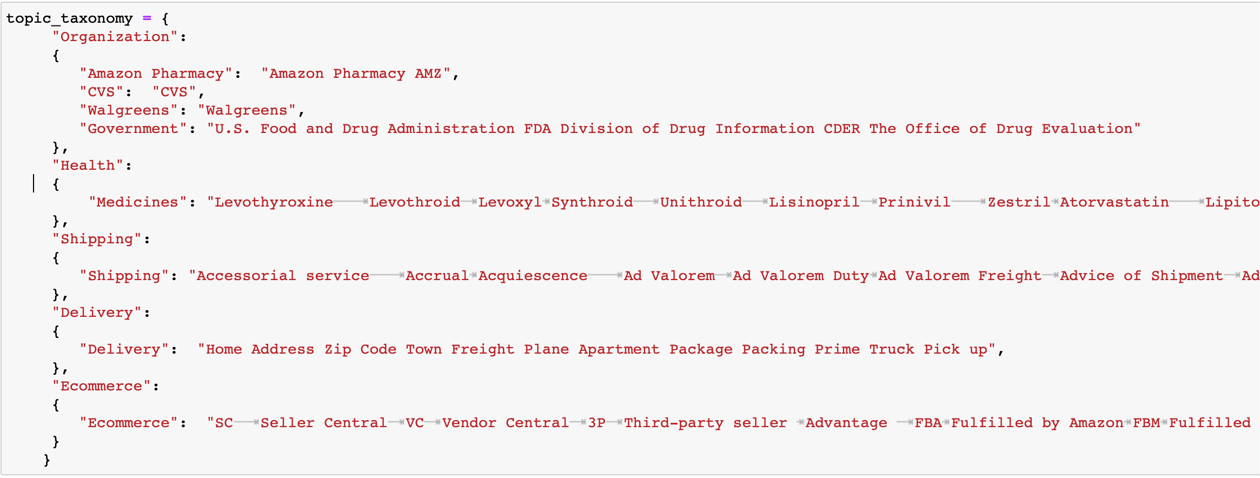
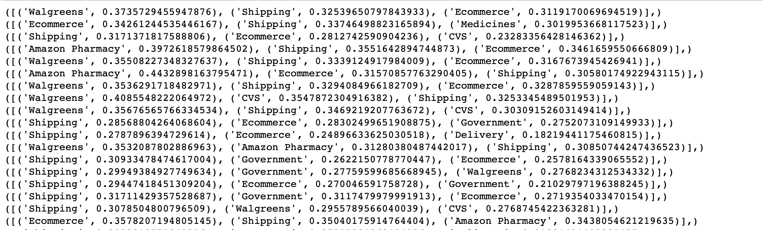
Topic Clustering - Topic Taxonomy
https://www.healthgrades.com/right-care/patient-advocate/the-top-50-drugs-prescribed-in-the-united-states, https://clincalc.com/DrugStats/Top300Drugs.aspx https://www.oocl.com/eng/resourcecenter/shippinglossary/Pages/default.aspx

Slide 13
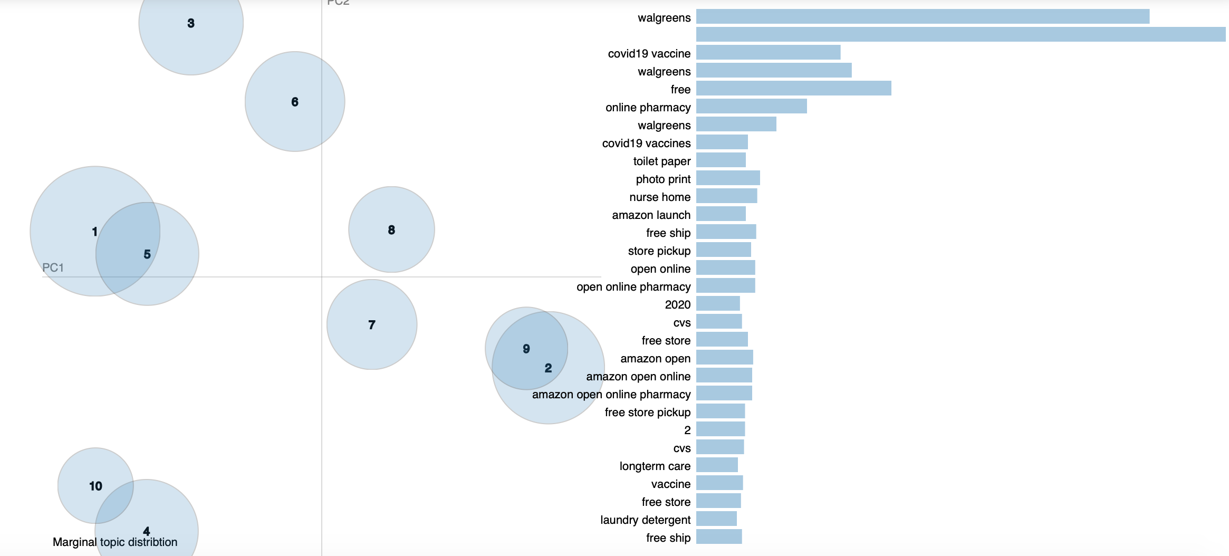
Topic Clustering - Walgreens Webhose
Processing:
More than 19.000 posts
LDA Topic Modeling
Safety and delivery specific taxonomy
Implications:
No visible complaints on their services
Lots of key words referring to competitors and industry landscape
35
25
22
15

Slide 14
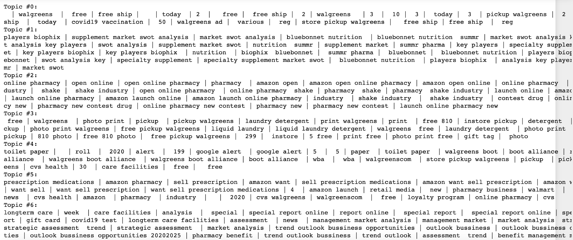
Topic Clustering - Walgreens Webhose

Slide 15
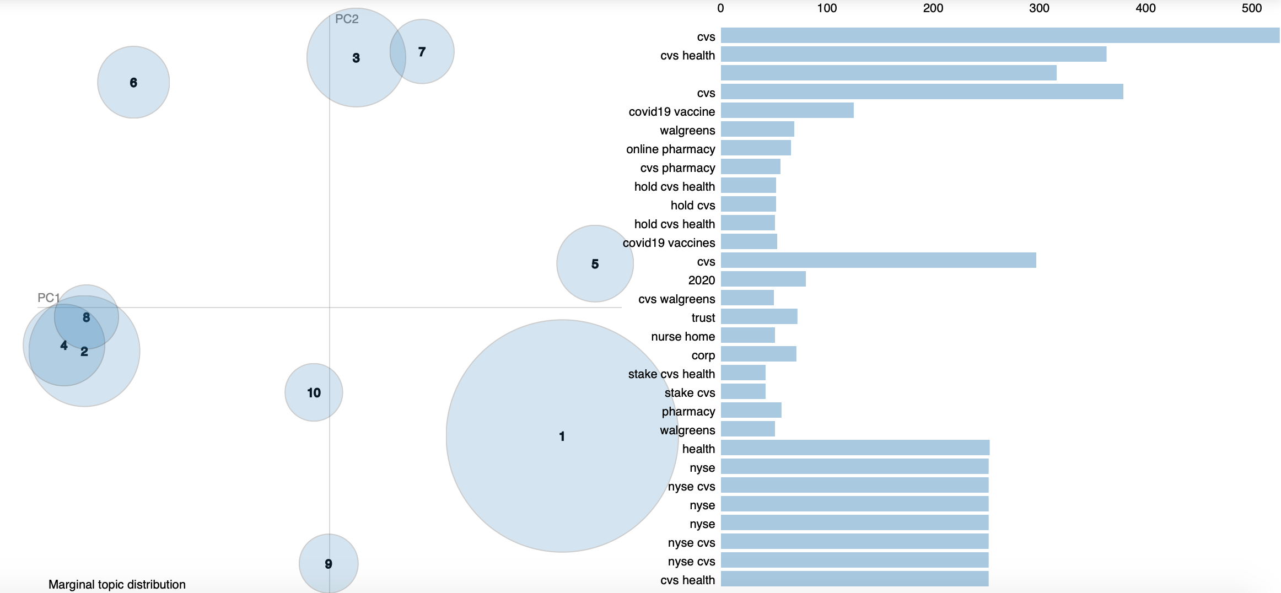
Topic Clustering - CVS Webhose
Processing:
More than 19.000 posts
LDA Topic Modeling
Safety and delivery specific taxonomy
Implications:
No apparent complaints on their services
Lots of key words referring to multiple and separate topics
35
25
22
15

Slide 16
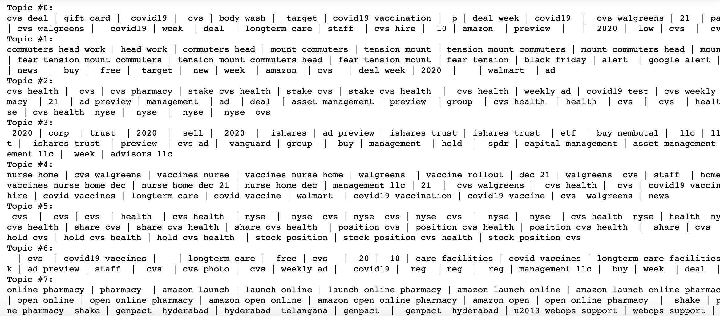
Topic Clustering - CVS Webhose

Slide 17
Model Evaluation
Internal Validity
Evaluated coherence scores using c_v measure
Criteria
Comparison with other incumbents to cross-validate topics, looking specifically at safety and delivery
Findings
Safety/Delivery doesn’t seem to be a concern
Wide range of topics
Unlike themes between companies’ feeds
The large amount of text related to COVID confounded the analysis

Slide 18
Lessons Learned
Further preliminary analysis of text corpus
Crawl for older data (pre-COVID)
Proof of concept
Number of available feeds
Relevant content
COVID chatter and articles overshadowed other topics that may have been relevant
Free APIs have timespan limitations
Given limitations, this may be more suited as proof-of-concept

Slide 19

Questions?

Slide 20
THANK YOU

